Slide 1
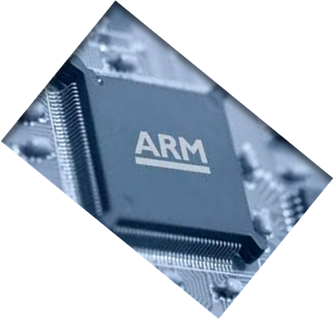

MICROPROCESSOR AND COMPUTER ARCHITECTURE
CACHE
OPTIMIZATION
Credits:
MPCA Team

Slide 2
CACHE OPTIMIZATIONS - RECAP
Average access time = Hit time + Miss rate x Miss penalty
Six “easy” ways to improve above equation
Reducing miss rate:
1. Larger block size (compulsory misses)
2. Larger cache size (capacity misses)
3. Higher associativity (conflict misses)
Reducing miss penalty:
4. Multilevel caches
5. Prioritize reads over writes
Reducing hit time:
6. Avoiding address translation

Slide 3
CACHE OPTIMIZATIONS - RECAP
Uniprocessor misses fall into three categories:
Compulsory: First access (ever to location)
Capacity : Program accesses more than will fit in cache
Conflict: Too many blocks map to given set
  Sometimes called collision miss
  Can’t happen in fully associative caches

Slide 4
CACHE OPTIMIZATIONS- REDUCE MISS RATE
FIRST OPTIMIZATION : Larger Block Size to Reduce Miss Rate
Brings in more data per miss
    Reduce compulsory misses
  Larger block size take advantage of principle of locality
    Temporal & Spatial Locality
  Unfortunately can increase conflict and capacity misses.
  Increase Miss Penalty. May compensate the decrease in miss rate.
Selection of the block size:
  Latency & Bandwidth of the lower level memory.
  High Latency & High Bandwidth encourage large block size.
  Low Latency & Low Bandwidth encourage small block size.
Ex: Twice miss penalty of a small block may be close to the penalty of a block twice the size

Slide 5
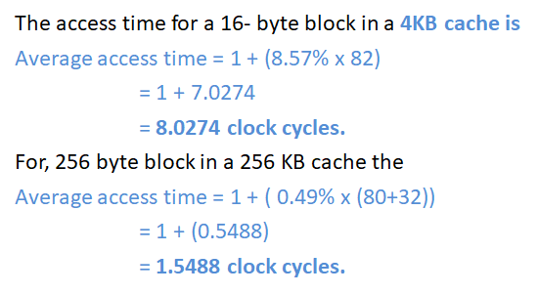
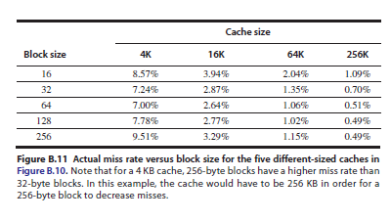
Example 1: Assume the memory system takes 80 clock cycles of overhead and then delivers 16 bytes every 2 clock cycles. That is, it can supply 16 bytes in 82 clock cycles, 32 bytes in 84 clock cycles, and so on… Which block size has the smallest average memory access time for each cache size?
Ans: Average access time = Hit time + Miss rate x Miss penalty
If we assume that the hit time is 1 clock cycle independent of the block size, then,

Slide 6
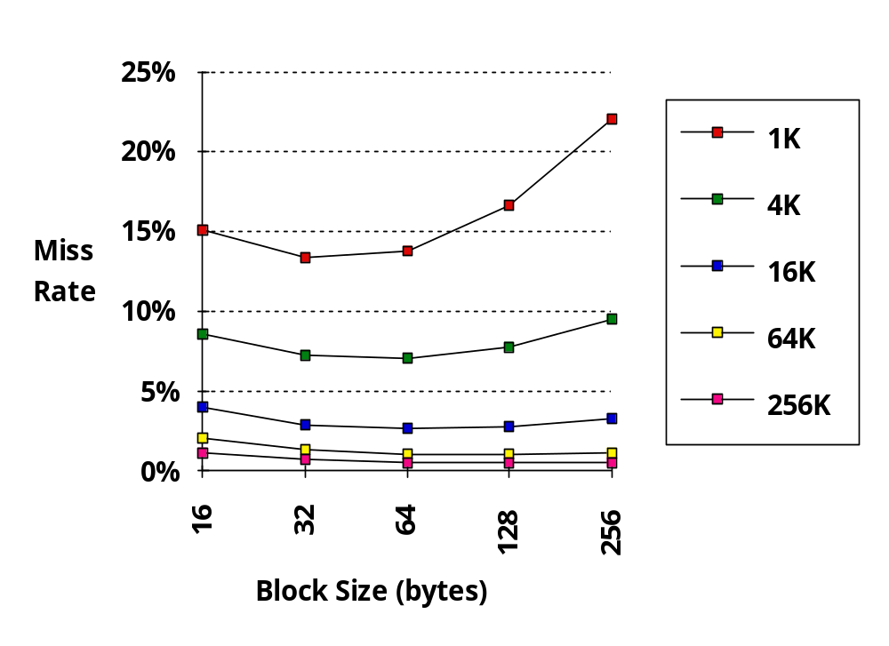
Miss rate Vs Block size: Larger Block Size (fixed size & assoc)
Reduced
compulsory
misses
Increased
Conflict
Misses
What else drives up block size? - Associativity

Slide 7
SECOND OPTIMIZATION :
Larger Caches to Reduce Miss Rate
Increase Cache Capacity to reduce capacity misses.
Very popular in Off- chip caches.
Drawbacks:
  Longer hit time
  Higher cost & power.

Slide 8
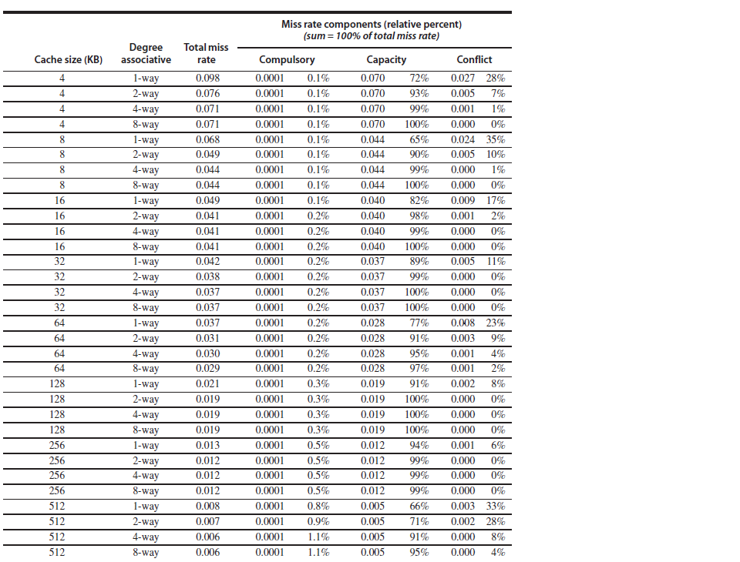
THIRD OPTIMIZATION :
Higher Associativity to Reduce Miss Rate
Comparision:
Data suggests 8 way associative is often as good as fully associative.
2:1 cache rule (for cache size 128KB)
A direct-mapped cache of size N has the same miss rate of 2-way associative cache of size N /2.
Problem: Greater associativity comes at the cost of increased hit time

Slide 9
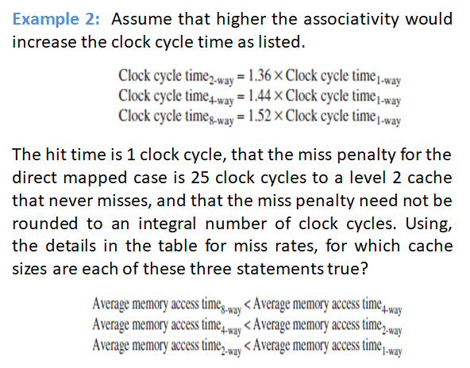
THIRD OPTIMIZATION :
Higher Associativity to Reduce Miss Rate

Slide 10
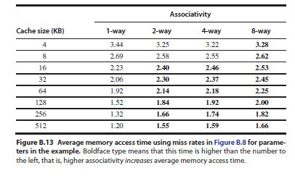
CACHE OPTIMIZATIONS- THIRD OPTIMIZATION
Ans:
Average memory
access time _{8-way} = Hit Time + Miss Rate x Miss Penalty
= 1.52 + Miss Rate x 25
access time 4_{-way} = 1.44 + Miss Rate x 25
access time 2_{-way} = 1.36 + Miss Rate x 25
access time _{1way} = 1.00 + Miss Rate x 25
The miss penalty is the same time in each case, i.e, 25 clock cycles.
Ex: The average memory access time for 4KB direct–mapped cache is
Average memory = 1.00 + ( 0.098 x 25) = 3.45
access time _{1-way}
And the time for a 512 KB, eight-way set associative cache is
Average memory = 1.52 + (0.006 x 25) = 1.67
access time _{8-way}

Slide 11
Fourth optimization:
Multilevel Caches to Reduce Miss Penalty
Observing the cache performance formula,
  Avg. memory access time = Hit time + Miss rate x Miss penalty
Improvements in Miss penalty is as advantageous as improvements in miss rate.
The performance gap between processor & memory raises a question:
  Should I make the cache faster to keep the pace with the speed of the processor? Or
  Make the cache larger to overcome the widening gap between the processor & the main memory?

Slide 12
Fourth optimization:
Multilevel Caches to Reduce Miss Penalty
Answer for these questions is to do both.
  Adding another level of cache between memory & original cache simplifies the decision.
First level cache can be small enough to match the clock cycle time of the processor.
Second level cache be can be large enough to capture many accesses that would go to main memory, thus reducing miss penalty.

Slide 13
Fourth optimization:
Multilevel Caches to Reduce Miss Penalty
Multilevel cache will complicate performance analysis.
Considering Memory access time for a two level cache using subscripts L1 & L2 to refer, respectively, to the first & second level
The original formula is:
AMAT = Hit Time_{L1} + Miss Rate_{L1} x Miss Penalty_{L1}

Slide 14
Fourth optimization:
Multilevel Caches to Reduce Miss Penalty
and
Miss Penalty_{L1} = Hit Time_{L2} + Miss Rate_{L2} x Miss Penalty_{L2}
Substituting in original equation, we get,
AMAT = Hit Time_{L1} + Miss Rate_{L1} x [Hit Time_{L2} + Miss Rate_{L2} x Miss Penalty_{L2}]
Here, Second level miss rate is measured on the leftovers from the first level cache.
To avoid ambiguity, the following terms are used for a two level cache system.
  Local miss rate
  Global miss rate

Slide 15
Fourth optimization:
Multilevel Caches to Reduce Miss Penalty
Local miss rate:
The number of misses in the cache divided by the total number of memory accesses to this cache.
Ex: For first level cache it is, Miss Rate_{L1}
For second level cache it is, Miss Rate_{L2}
Global miss rate:
The number of misses in the cache divided by the total number of memory accesses generated by the processor.
Ex: Global miss rate for level1 cache is still Miss Rate_{L1}
but, for level2 cache it is : Miss Rate_{L1} x Miss Rate_{L2}

Slide 16
Fourth optimization:
Multilevel Caches to Reduce Miss Penalty
Local miss rate is large for second level caches because
  The first level cache skims the cream of the memory accesses.
  Global miss rate is more useful measure.
    It indicates what fraction of the memory accesses that leave the processor go all the way to memory.
  Here, the misses per instruction metric shines.
  Expanding the memory stalls per instruction to add the impact of a second level,
  Avg. Memory stalls per instruction = Misses per instruction_{L1} x Hit Time_{L2} + Misses per instruction_{L2} x Miss Penalty_{L2}

Slide 17
Fourth optimization:
Multilevel Caches to Reduce Miss Penalty - Example
Suppose that in 1000 memory references there are 40 misses in the first level cache and 20 misses in the second –level cache. What are the various miss rates?
Assume the miss penalty from the L2 cache to memory is 200 clock cycles, the hit time of the L2 cache is 10 clock cycles, hit time for L1 cache is 1 clock cycle and there are 1.5 memory references per instruction.
What is the average memory access time and average stall cycles per instruction?
Ignore impact of writes.

Slide 18
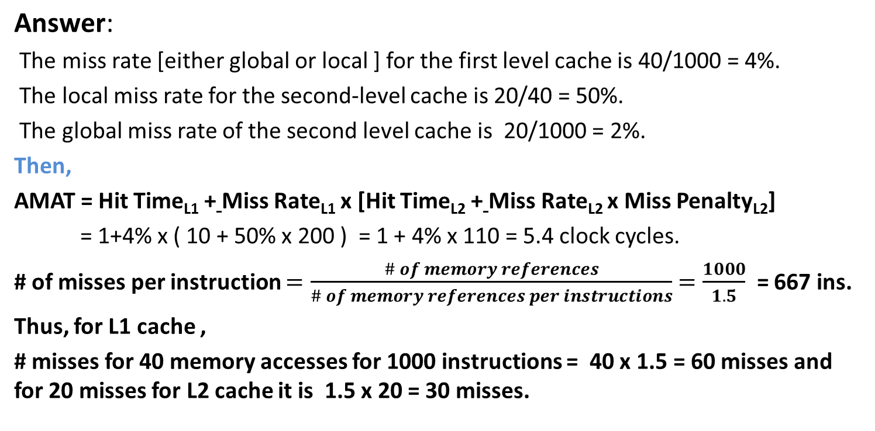
Fourth optimization:
Multilevel Caches to Reduce Miss Penalty - Example

Slide 19
Fourth optimization:
Multilevel Caches to Reduce Miss Penalty - Example
Average memory stalls per instruction = Misses per instruction _{L1} x Hit time_{L2} + Misses per instruction _{L2} x Miss Penalty
= (60/1000) x 10 + (30/1000) x 200
= 0.06 x 10 + 0.03 x200 = 0.06 + 6
= 6.6 clock cycles.
Then, Average memory = (AMAT - Hit time_{L1} ) x Average # of memory references per stalls per instruction
= ( 5.4 - 1.0) x 1.5 = 6.6 clock cycles.
Note: The computation of the memory stalls per instruction is same for either way.

Slide 20
Fourth optimization:
Multilevel Caches to Reduce Miss Penalty
Note:
Formulae are for combined reads & writes.
A write back first level cache
A write-through first level cache will send
      Misses
      All writes to the second level
      May use a write buffer.

Slide 21
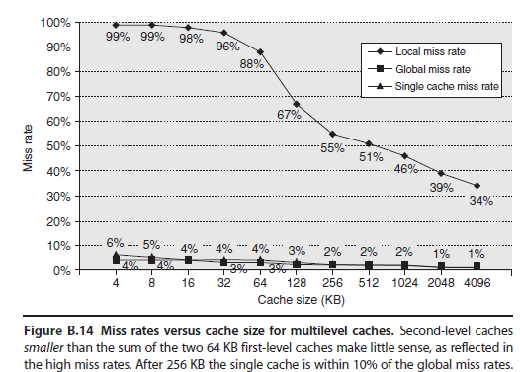
Fourth optimization:
Multilevel Caches to Reduce Miss Penalty
First perspective :
Global cache miss rate is very similar to the single cache miss rate of the second level cache.
  Provided that the second level cache is much larger than the first level cache.
Notes:
Mar 9, 2020

Slide 22
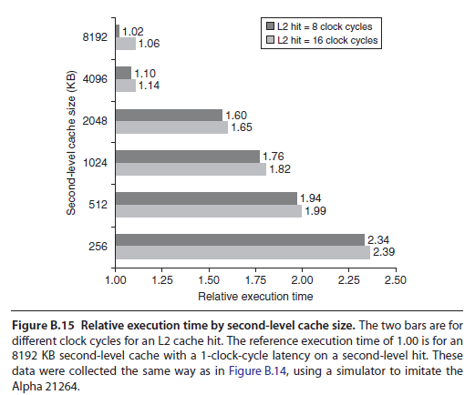
Fourth optimization:
Multilevel Caches to Reduce Miss Penalty
Second Perspective:
Local cache miss rate is not a good measure of secondary caches.
It is a function of the miss rate of the first level cache.
Can vary by changing the first – level cache.
Note: Global cache miss rate should be used when evaluating second level caches.
Notes:
Mar 9, 2020

Slide 23
Fourth optimization:
Multilevel Caches to Reduce Miss Penalty
Parameters for second level caches:
  Difference between two levels is the speed of the first level cache
    That affects the clock rate of the processor.
    While, Speed of the second level cache only affects the miss penalty of the first level cache.
    Thus, many alternatives can be considered in second level cache that are ill chosen for the first level cache.
    Two major questions for the design of the second level cache:
      Will it lower the average memory access time portion of the CPI?
      How much does it cost ?
Notes:
Mar 9, 2020

Slide 24
Fourth optimization:
Multilevel Caches to Reduce Miss Penalty
Initial decision is the size of a second level cache.
Everything in first level cache is likely in the second level cache.
The size of the second level cache should be much higher than the first.
If second level caches are just a little bigger, the local miss rate will be higher.
Thus, inspires the design of huge second level caches.
NOTE: Multi level inclusion is the natural policy for memory hierarchies.
  L1 data is always present in L2.
Notes:
Mar 9, 2020

Slide 25
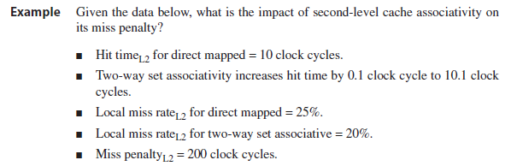


Fourth optimization:
Multilevel Caches to Reduce Miss Penalty
Notes:
Mar 9, 2020

Slide 26
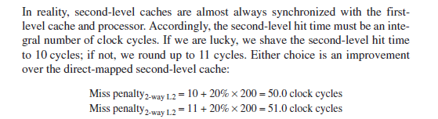
Fourth optimization:
Multilevel Caches to Reduce Miss Penalty
Notes:
Mar 9, 2020

Slide 27
Fourth optimization:
Multilevel Caches to Reduce Miss Penalty
The essence of all cache designs is:
Balancing fast hits and few misses.
For second level caches,
  Many fewer hits than in the first level cache.
  Emphasis shifts to fewer misses.
Insight leads to much larger caches and techniques to lower the miss rate:
  Such as higher associativity & larger blocks.
Notes:
Mar 9, 2020

Slide 28
Fifth optimization: Giving priority to Read misses over Write misses to reduce miss penalty
This optimization serves reads before writes have been completed.
Complexities of a write buffer with a write-through cache:
    The most improvement is a write buffer of a proper size.
    Memory accesses are complicated as it may hold the updated value of a location needed on a read miss.
Notes:
Mar 9, 2020

Slide 29
Fifth optimization: Giving priority to Read misses over Write misses to reduce miss penalty
  To resolve this ambiguity,
    Read miss to wait until the write buffer is empty.
    or
    To check the contents of the write buffer on a read miss and if there are no conflicts and the memory system is available.
    Let the read miss continue.
    Virtually, all processors use the later approach.
    Gives priority reads over writes.
Notes:
Mar 9, 2020

Slide 30
Fifth optimization: Giving priority to Read misses over Write misses to reduce miss penalty
Write-back cache:
    The cost of the writes by the processor in a write back can also be reduced.
    Consider a read miss replacing a dirty block.
    Instead of writing the dirty block to the memory, and then reading memory, we could copy the dirty block to a buffer, then read memory and then write memory will finish sooner.
    Thus, if a read miss occurs, the processor can either stall until the buffer is empty or
    Check the addresses of the words in the buffer for conflicts.
Notes:
Mar 9, 2020

Slide 31
Fifth optimization: Giving priority to Read misses over Write misses to reduce miss penalty
Consider the following code sequence.
Ex: STR R3, 512 (R0)
LDR R1, 1024 ( R0)
LDR R2, 512 (R0) Assume Direct mapped:
Write –through cache that maps 512 and 1024 to the same block. Four word write buffer that is not checked on a read miss. Will the value in R2 always be equal to the value in R3? o R2!
Notes:
Mar 9, 2020

Slide 32
Fifth optimization: Giving priority to Read misses over Write misses to reduce miss penalty
Ans:
This is a read-after-write data hazard in memory.
The data in R3 are placed into the write buffer after the STR.
The following LDR instruction uses the same cache index and is therefore a miss.
The second LDR instruction, tries to put the value in location 512 into the register R2.
This also results in a miss.
If the write buffer hasn’t completed writing to location 512 in memory,
The read of location 512 will put the old, wrong value into the cache block and then into R2.
Without proper precautions, R3 would not be equal to R2!
Notes:
Mar 9, 2020

Slide 33
Q & A
Cache Optimizations
Notes:
Mar 9, 2020

